Slide 1

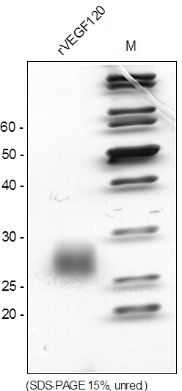
ReliaTech GmbH
Recombinant rat VEGF120
(Cat #R20-063 / -064)
Fig. 1: SDS-PAGE analysis of recombinant rat VEGF120 produced in E. coli. Sample was loaded in 15% SDS-polyacrylamide gel under non-reducing reducing conditions and stained with Silver stain.
http://www.reliatech.de / orders@reliatech.de

